Slide 1
Switching Techniques

Slide 2
Introduction
In large networks there might be multiple paths linking sender and receiver.
It is necessary to develop suitable mechanism for communication between any two devices.
Information may be switched as it travels through various communication channels.
One alternative is to establish point-to-point communication between each pair of devices. However, it is impractical for large number of devices, because the number of links increases exponentially (n(n-1)/2, where n is the number of devices) with the number of devices.
A better alternative is to use switching techniques leading to switched communication network. In the switched network methodology, the network consists of a set of interconnected nodes, among which information is transmitted from source to destination via different routes, which is controlled by the switching mechanism.
There are three typical switching techniques available for digital traffic.
  Circuit Switching
  Message Switching
  Packet Switching

Slide 3
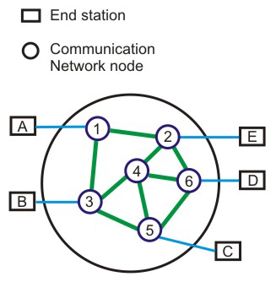
Contd.
A basic model of a switched communication is shown in Fig. 4 The end devices that wish to communicate with each other are called stations. The switching devices are called nodes. Some nodes connect to other nodes and some are to connected to some stations.
Key features of a switched communication network are given below:
Network Topology is not regular.
Uses FDM or TDM for node-to-node communication.
There exist multiple paths between a source-destination pair for better network reliability.
The switching nodes are not concerned with the contents of data.
Their purpose is to provide a switching facility that will move data from node to node until they reach the destination.

Slide 4
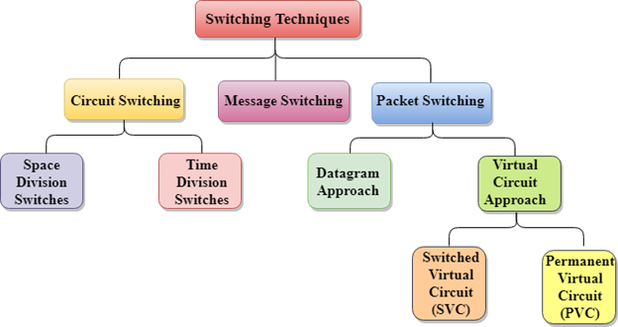
Contd.

Slide 5
Circuit Switching Techniques
Communication via circuit switching implies that there is a dedicated communication path between the two stations. The path is connected through a sequence of links between network nodes. On each physical link, a logical channel is dedicated to the connection. Circuit switching is commonly used technique in telephony, where the caller sends a special message with the address of the callee (i.e. by dialling a number) to state its destination. It involved the following three distinct steps,
Circuit Establishment: To establish an end-to-end connection before any transfer of data.
  Some segments of the circuit may be a dedicated link, while some other segments may be shared.
Data transfer:
  Transfer data is from the source to the destination.
  The data may be analog or digital, depending on the nature of the network.
  The connection is generally full-duplex.
Circuit disconnect:
  Terminate connection at the end of data transfer.
  Signals must be propagated to deallocate the dedicated resources. A

Slide 6
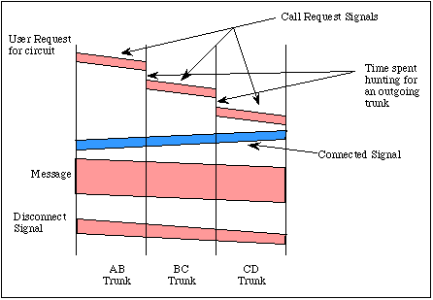

Contd.
A connection between two systems A & D formed from 3 links
A circuit switched connection between A and D

Slide 7
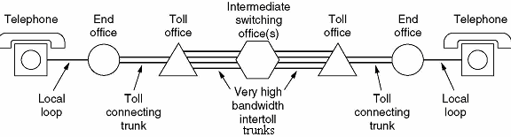
Contd.
Circuit switching in a network operates almost the same way as the telephone system works.
A complete end-to-end path must exist before communication can take place.
The computer initiating the data transfer must ask for a connection to the destination.
Once the connection has been initiated and completed to the destination device, the destination device must acknowledge that it is ready and willing to carry on a transfer.

Slide 8
Contd.
Circuit Switching can use either of the two technologies:
  Space Division Switches
  Time Division Switches

Slide 9
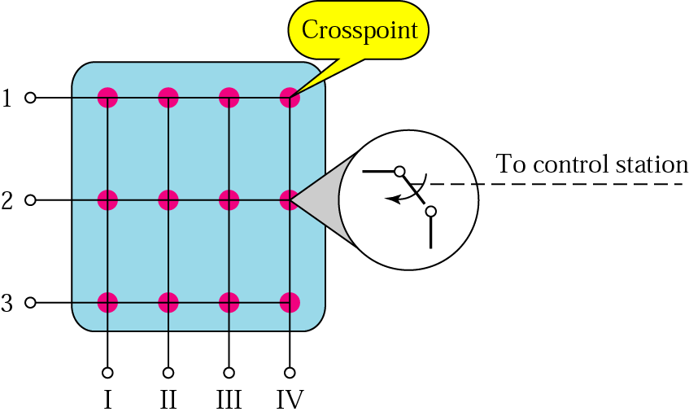
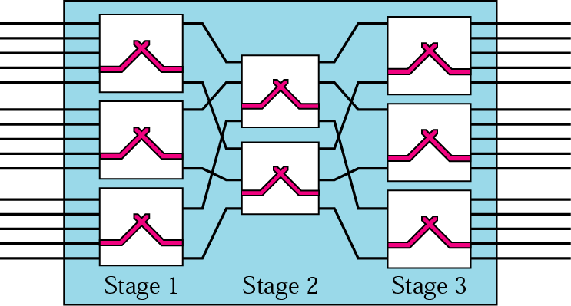
Space Division Switches
Space Division Switching is a circuit switching technology in which a single transmission path is accomplished in a switch by using a physically separate set of crosspoints.
Space Division Switching can be achieved by using crossbar switch. A crossbar switch is a metallic crosspoint or semiconductor gate that can be enabled or disabled by a control unit.
The Crossbar switch is made by using the semiconductor.
Space Division Switching has high speed, high capacity, and non blocking switches.
Space Division Switches can be categorized in two ways:
  Crossbar Switch
  Multistage Switch
  [Crossbar Switch]
  [Multistage Switch]

Slide 10
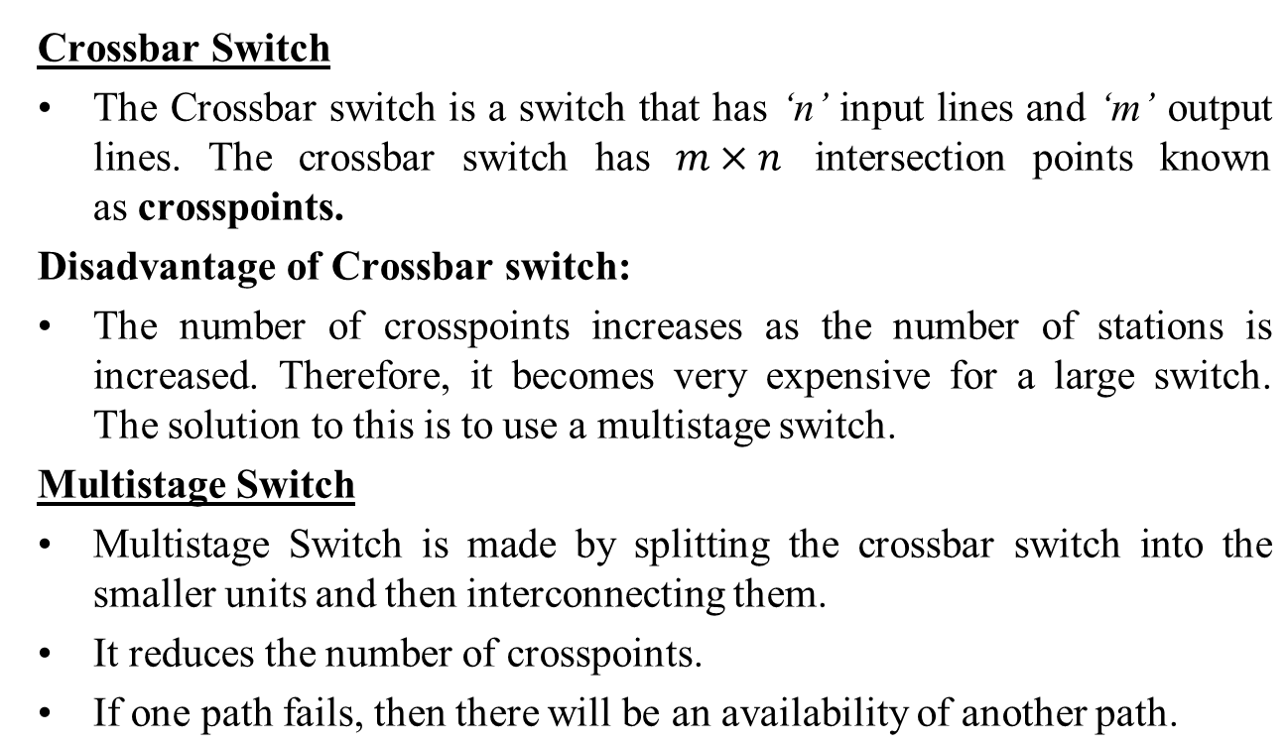
Contd.

Slide 11
Time Division Switching
Time division switching comes under digital switching techniques, where the Pulse Code Modulated signals are mostly present at the input and the output ports. A digital Switching system is one, where the inputs of any PCM highway can be connected to the outputs of any PCM highway, to establish a call.
The incoming and outgoing signals when received and re-transmitted in a different time slot, is called Time Division Switching. The digitized speech information is sliced into a sequence of time intervals or slots. Additional voice circuit slots, corresponding to other users are inserted into this bit stream of data. Hence, the data is sent in time frames.

Slide 12
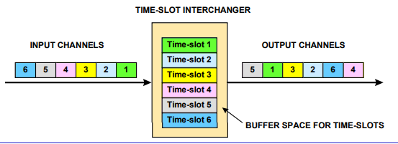
Contd.
Time division switches use time division multiplexing, in switching.
The two popular methods of TDM are TSI (Time and Slot Interchange) and TDM bus.
The data sent at the transmitter reaches the receiver in the same order, in an ordinary time division multiplexing whereas, in TSI mechanism, the data sent is changed according to the ordering of slots based on the desired connections.
It consists of RAM with several memory locations such as input, output locations and control unit.
Time-slot interchanger is a device, which buffers ‘m’ incoming timeslots, e.g. 30 time-slots of an E1 frame, arranges new transmit order and transmits ‘n’ time-slots.
Time-slots are stored in buffer memory usually in the order they arrive or in the order they leave the switch - additional control logic is needed to decide respective output order or the memory slot where an input slot is stored

Slide 13
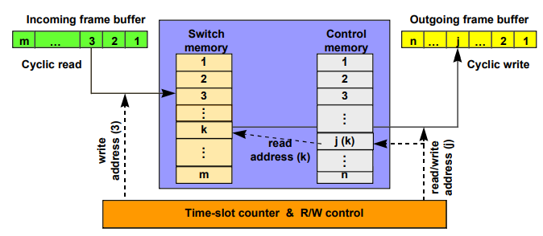
Contd.
Incoming time-slots are written cyclically into switch memory
Output logic reads cyclically control memory, which contains a pointer for each output time-slot
Pointer indicates which input time-slot to insert into each output time-slot

Slide 14
Pros & Cons of Circuit Switching
Advantages:
After path is established, data communication without delay.
Very suitable for continuous traffic.
It establishes a dedicated path.
No overhead after call setup.
it is transparent and data passes in order.
Disadvantages:
Provide initial delay for setting up the call.
Inefficient for bursty traffic.
Data rate should be same because of fixed bandwidth.
When load increases, some calls may be blocked.
In data communication, traffic between terminal and server are not continuous. Sometimes more data may come or sometimes there is no data at all. Circuit switching is not efficient because of its fixed bandwidth.

Slide 15
Message Switching
With message switching there is no need to establish a dedicated path between two stations.
When a station sends a message, the destination address is appended to the message.
The message is then transmitted through the network, in its entirety, from node to node.
Each node receives the entire message, stores it in its entirety on disk, and then transmits the message to the next node.
This type of network is called a store-and-forward network.

Slide 16
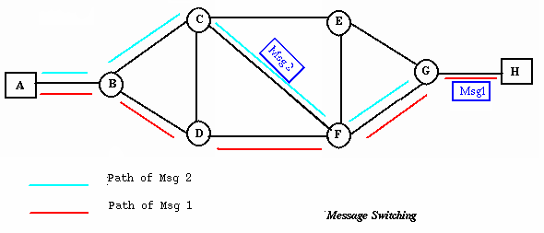
Contd.
A message-switching node is typically a general-purpose computer.
The device needs sufficient secondary-storage capacity to store the incoming messages, which could be long.
A time delay is introduced using this type of scheme due to store- and-forward time, plus the time required to find the next node in the transmission path.

Slide 17
Contd.
Advantages:
  Channel efficiency can be greater compared to circuit-switched systems, because more devices are sharing the channel.
  Traffic congestion can be reduced, because messages may be temporarily stored in route.
  Message priorities can be established due to store-and-forward technique.
  Message broadcasting can be achieved with the use of broadcast address appended in the message.
Disadvantages
  Message switching is not compatible with interactive applications.
  Store-and-forward devices are expensive, because they must have large disks to hold potentially long messages.

Slide 18
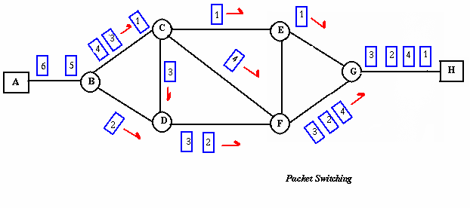
Packet Switching
Packet switching can be seen as a solution that tries to combine the
advantages of message and circuit switching and to minimize the
disadvantages of both.
There are two methods of packet switching: Datagram and virtual circuit.

Slide 19
Contd.
In both packet switching methods, a message is broken into
small parts, called packets.
Each packet is tagged with appropriate source and destination
addresses.
Since packets have a strictly defined maximum length, they
can be stored in main memory instead of disk, therefore access
delay and cost are minimized.
Also the transmission speeds, between nodes, are optimized.
With current technology, packets are generally accepted onto
the network on a first-come, first-served basis. If the network
becomes overloaded, packets are delayed or discarded
(``dropped'').

Slide 20
Packet switching
In packet switching, the analog signal from your phone is converted into a digital data stream. That series of digital bits is then divided into relatively tiny clusters of bits, called packets. Each packet has at its beginning the digital address -- a long number -- to which it is being sent. The system blasts out all those tiny packets, as fast as it can, and they travel across the nation's digital backbone systems to their destination: the telephone, or rather the telephone system, of the person you're calling.
They do not necessarily travel together; they do not travel sequentially. They don't even all travel via the same route. But eventually they arrive at the right point -- that digital address added to the front of each string of digital data -- and at their destination are reassembled into the correct order, then converted to analog form, so your friend can understand what you're saying.

Slide 21
Contd.
There are two approaches to Packet Switching:
  Datagram Packet switching:
  Virtual Circuit Switching

Slide 22
Contd.
Datagram Packet switching:
It is a packet switching technology in which packet is known as a datagram, is considered as an independent entity. Each packet contains the information about the destination and switch uses this information to forward the packet to the correct destination.
The packets are reassembled at the receiving end in correct order.
In Datagram Packet Switching technique, the path is not fixed.
Intermediate nodes take the routing decisions to forward the packets.
Datagram Packet Switching is also known as connectionless switching.

Slide 23
Packet Switching: Datagram
Datagram packet switching is similar to message switching in that each packet is a self-contained unit with complete addressing information attached.
This fact allows packets to take a variety of possible paths through the network.
So the packets, each with the same destination address, do not follow the same route, and they may arrive out of sequence at the exit point node (or the destination).
Reordering is done at the destination point based on the sequence number of the packets.
It is possible for a packet to be destroyed if one of the nodes on its way is crashed momentarily. Thus all its queued packets may be lost.

Slide 24
Packet Switching: Virtual Circuit
In the virtual circuit approach, a preplanned route is established before any data packets are sent.
A logical connection is established when
a sender send a "call request packet" to the receiver and
the receiver send back an acknowledge packet "call accepted
packet" to the sender if the receiver agrees on conversational
parameters.
The conversational parameters can be maximum packet sizes, path to be taken, and other variables necessary to establish and maintain the conversation.
Virtual circuits imply acknowledgements, flow control, and error control, so virtual circuits are reliable.
That is, they have the capability to inform upper-protocol layers if a transmission problem occurs.

Slide 25
Packet Switching: Virtual Circuit
In virtual circuit, the route between stations does not mean that
this is a dedicated path, as in circuit switching.
A packet is still buffered at each node and queued for output over
a line.
The difference between virtual circuit and datagram approaches:
With virtual circuit, the node does not need to make a routing
decision for each packet.
It is made only once for all packets using that virtual circuit.

Slide 26
Packet Switching: Virtual Circuit
VC's offer guarantees that
the packets sent arrive in the order sent
with no duplicates or omissions
with no errors (with high probability)
regardless of how they are implemented internally.

Slide 27
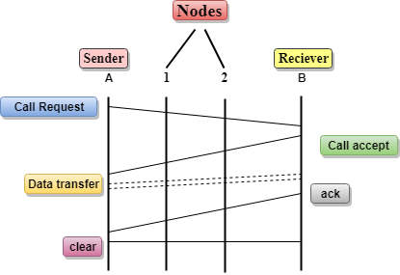
Contd.
In the above diagram, A and B are the sender and receiver respectively. 1 and 2 are the nodes.
Call request and call accept packets are used to establish a connection between the sender and receiver.
When a route is established, data will be transferred.
After transmission of data, an acknowledgment signal is sent by the receiver that the message has been received.
If the user wants to terminate the connection, a clear signal is sent for the termination.

Slide 28
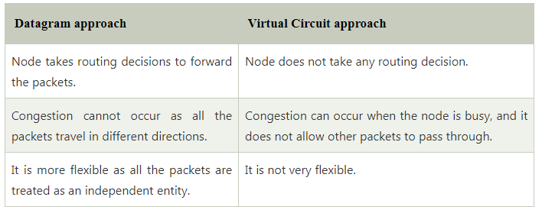
Contd.
Differences b/w Datagram approach and Virtual Circuit approach

Slide 29
Advantages of packet switching
Advantages:
  Packet switching is cost effective, because switching devices do not need massive amount of secondary storage.
  Packet switching offers improved delay characteristics, because there are no long messages in the queue (maximum packet size is fixed).
  Packet can be rerouted if there is any problem, such as, busy or disabled links.
  The advantage of packet switching is that many network users can share the same channel at the same time. Packet switching can maximize link efficiency by making optimal use of link bandwidth.

Slide 30
Disadvantages of packet switching
Disadvantages:
  Protocols for packet switching are typically more complex.
  It can add some initial costs in implementation.
  If packet is lost, sender needs to retransmit the data.
  Another disadvantage is that packet-switched systems still
  can’t deliver the same quality as dedicated circuits in
  applications requiring very little delay - like voice
  conversations or moving images.

Slide 31
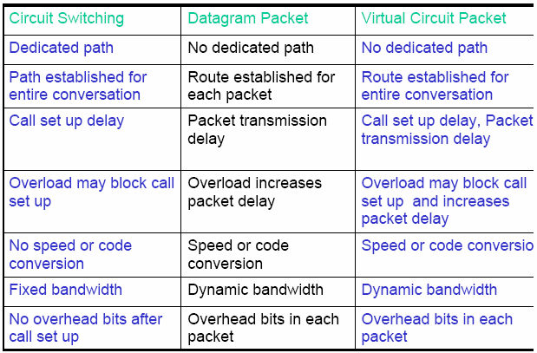
Comparison between Circuit Switching & Packet Switching

Slide 32
Queries

